Slide 1
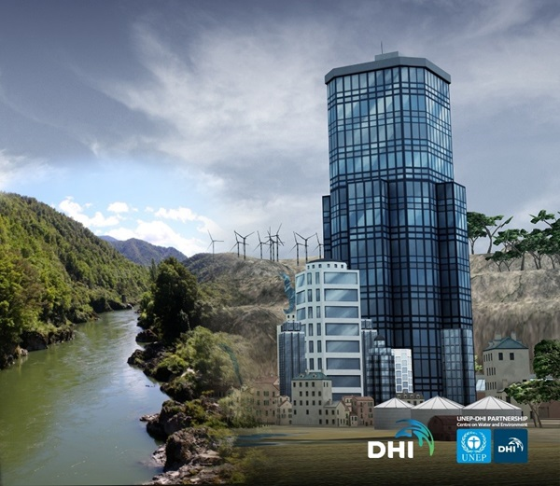
How to play the game
With Deli Connell
&
Carl Johnson
25 August 2016 – 4pm
© 2016 The University of Waikato www.sciencelearn.org.nz | All Rights Reserved.

Slide 2
How to play the game – Index
Topic Slide number(s)
Introducing this Science Learning Hub PD session 1–2
Aqua Republica 2016 dates to remember 3–4
Aqua Republica – logging in and getting started 5–6
Aqua Republica – how to play 7–14
Aqua Republica – tips and hints 15
Aqua Republica – how to sign up to play 16
Aqua Republica – sponsors thank you 17
Don’t miss webinar 3 – Aqua Republica post-game reflection 18
Supporting SLH resources 19
SLH promotional bookmarks, SLH links, thanks 20–21
© 2016 The University of Waikato www.sciencelearn.org.nz | All Rights Reserved.

Slide 3
Eco Challenge Schedule
1st Sept
Team and facilitators’ usernames
and temporary passwords provided.
Week 1
Learn-to-play week
Facilitators meet with teams and distribute usernames and passwords. If possible demonstrate how to find website and run through basics of game play using the Learn-to-play mission.
5th Sept

Slide 4
Eco Challenge Schedule
Week 2
Kaitiakitanga Challenge
This is the NZAR Eco-Challenge week.
At Monday lunch time all scores will be reset and the Kaitiakitanga mission begins. Facilitators may optionally meet with teams to discuss concepts or language issues, but should refrain from discussing game strategy directly.
12th Sept
18th Sept
Final scores for each team are captured.
Nov
Winning teams notified and prizes awarded.

Slide 5
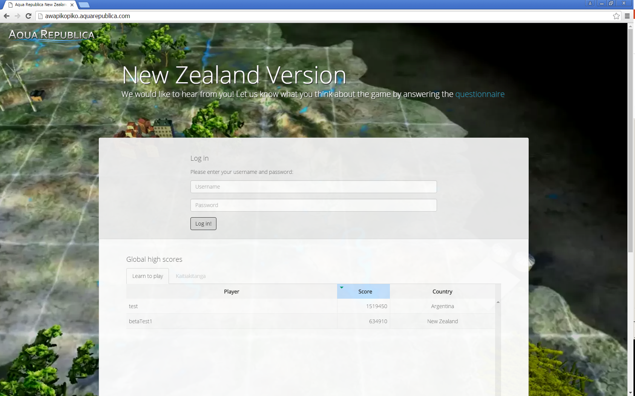
Log-In Interface

Slide 6
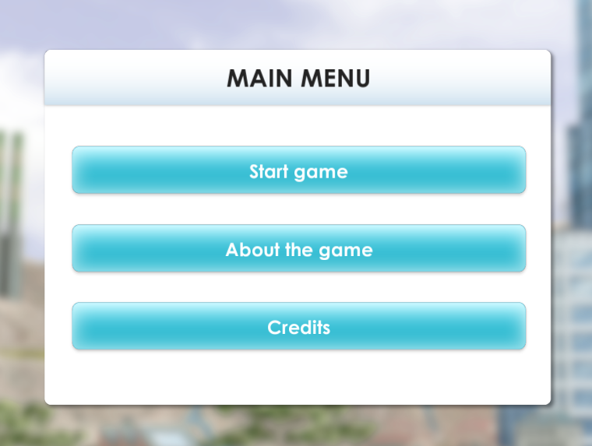
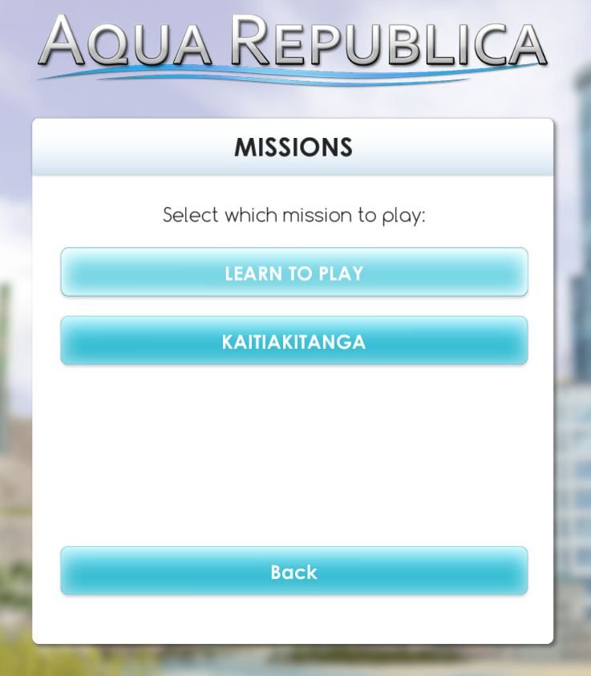
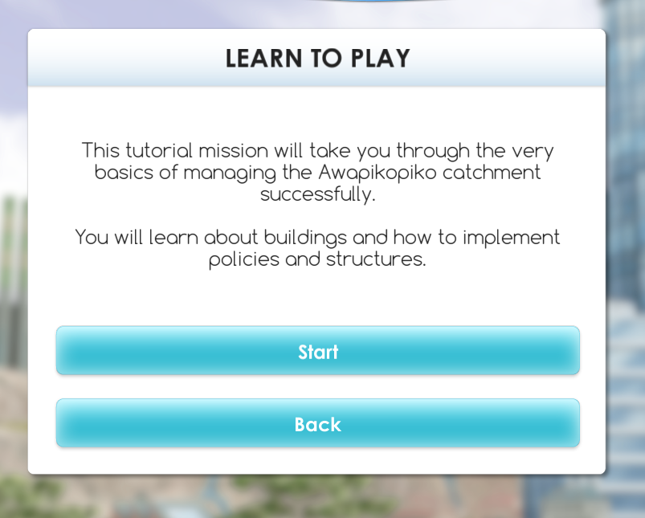
Getting Started

Slide 7
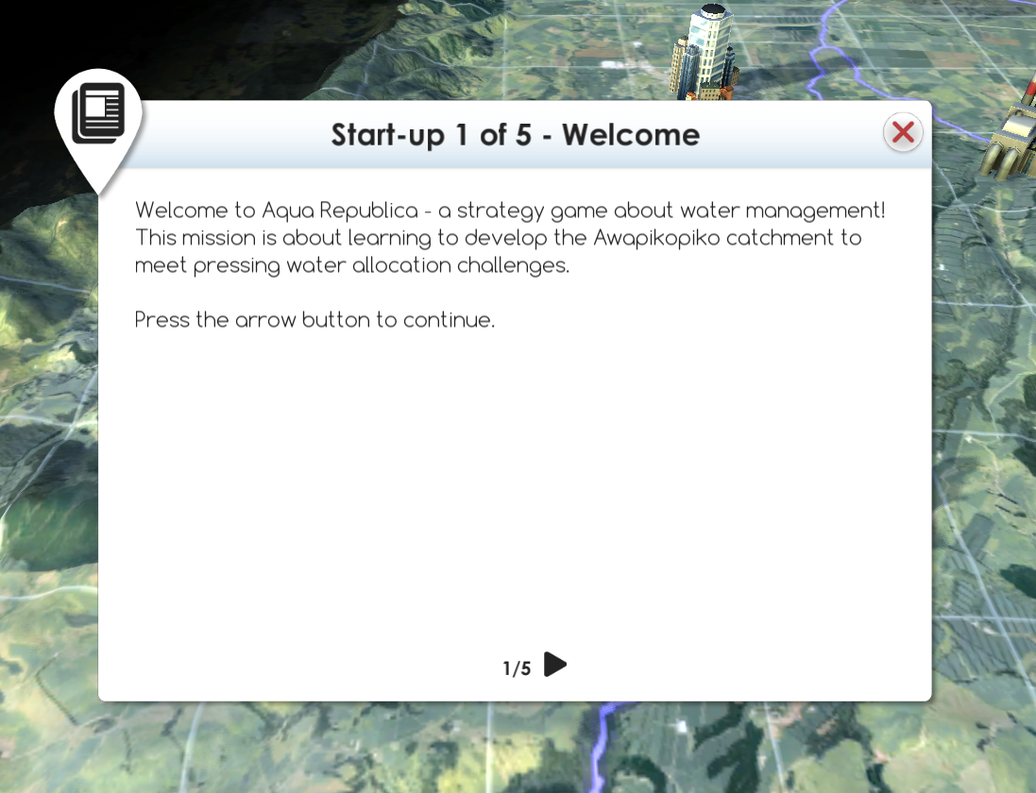
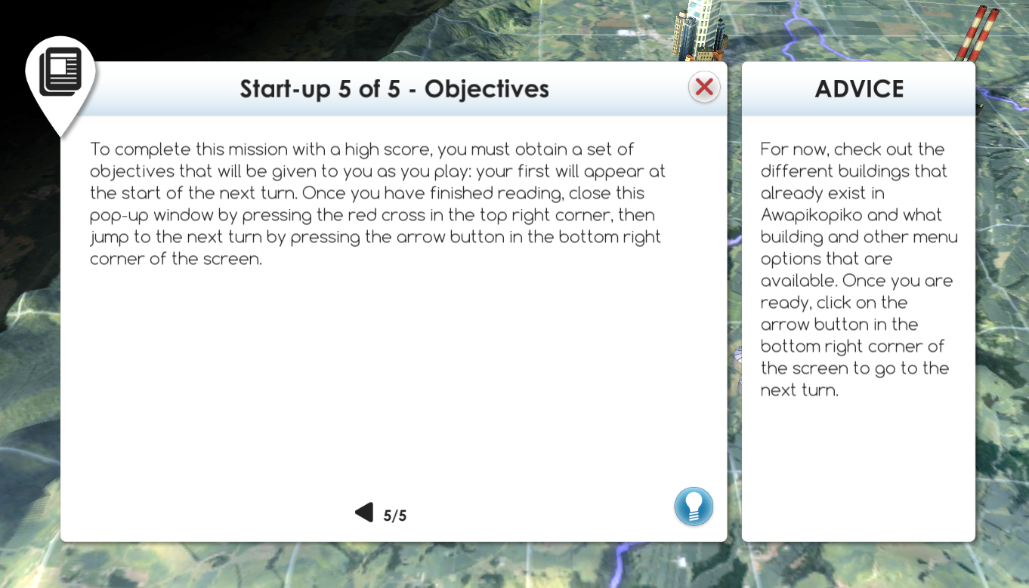
Self-led tutorials outline your game play

Slide 8
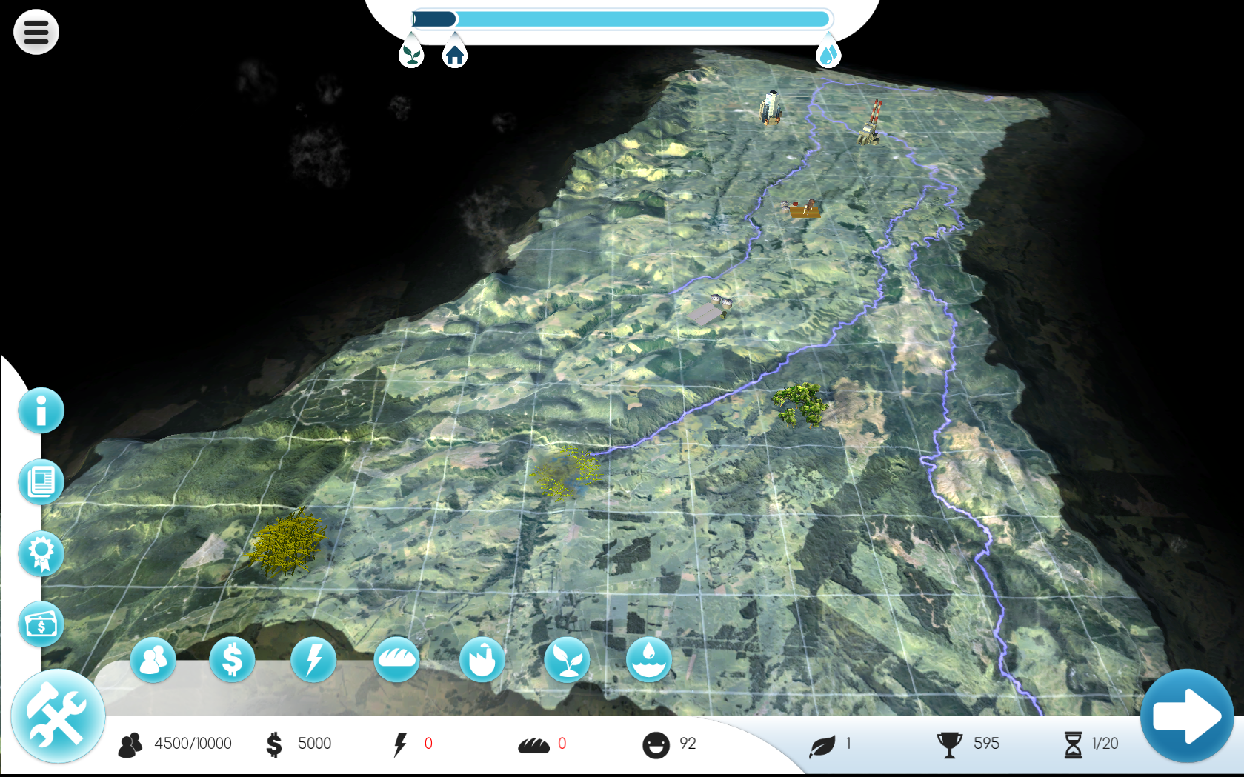
Learn-to-play game terrain

Slide 9
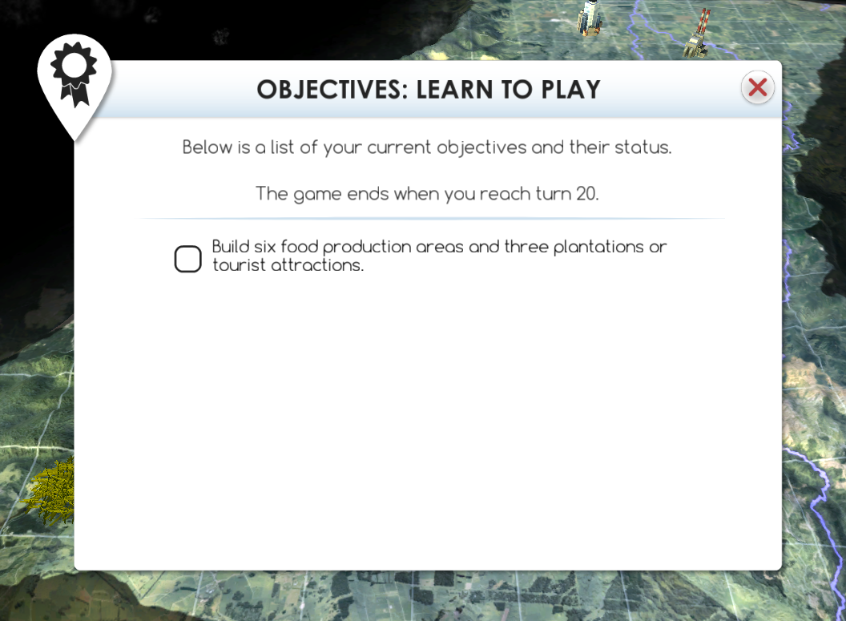
Objectives arise throughout game

Slide 10
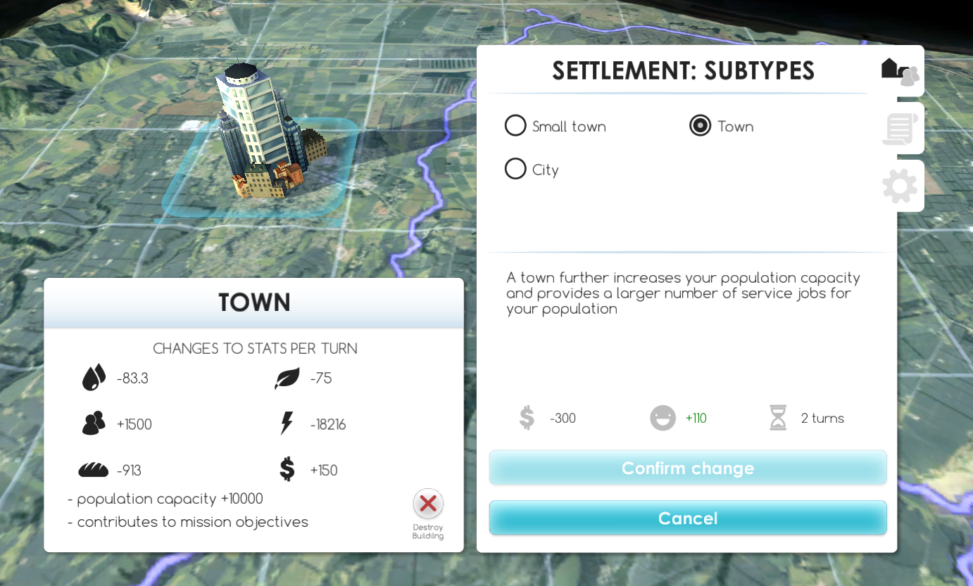
Infrastructures and buildings

Slide 11
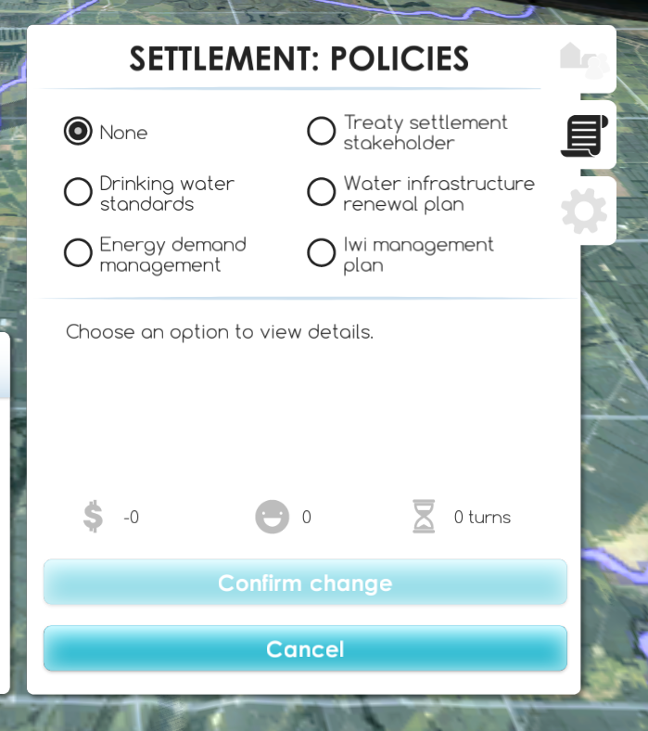
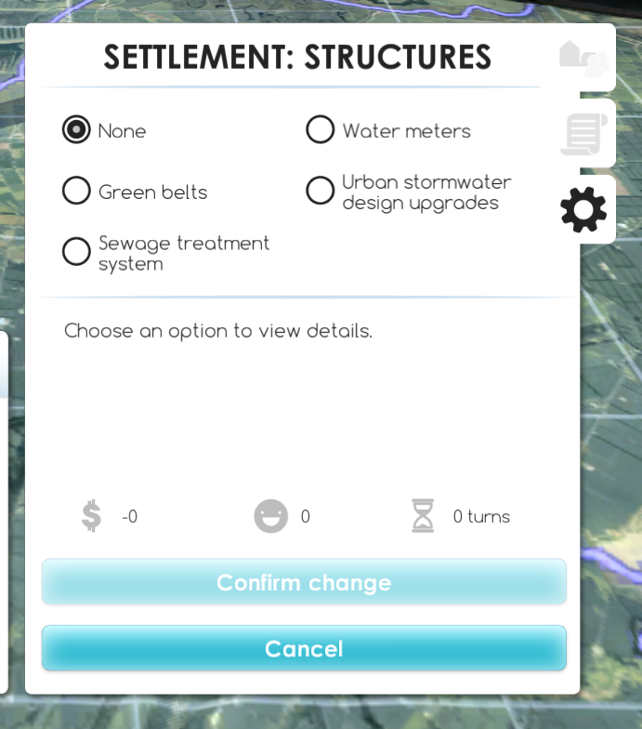
Add in policies and structures

Slide 12
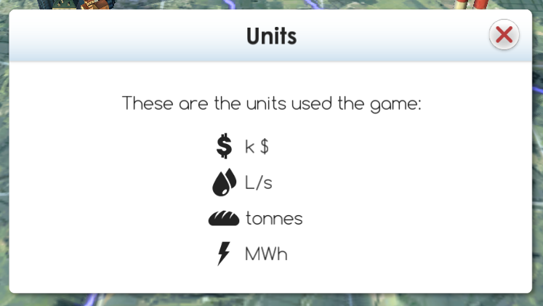
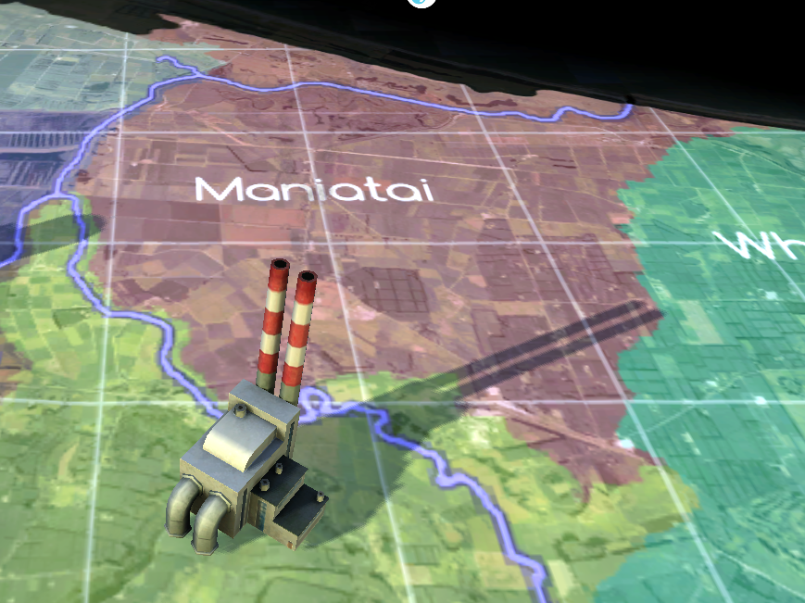
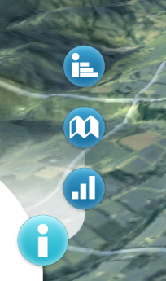
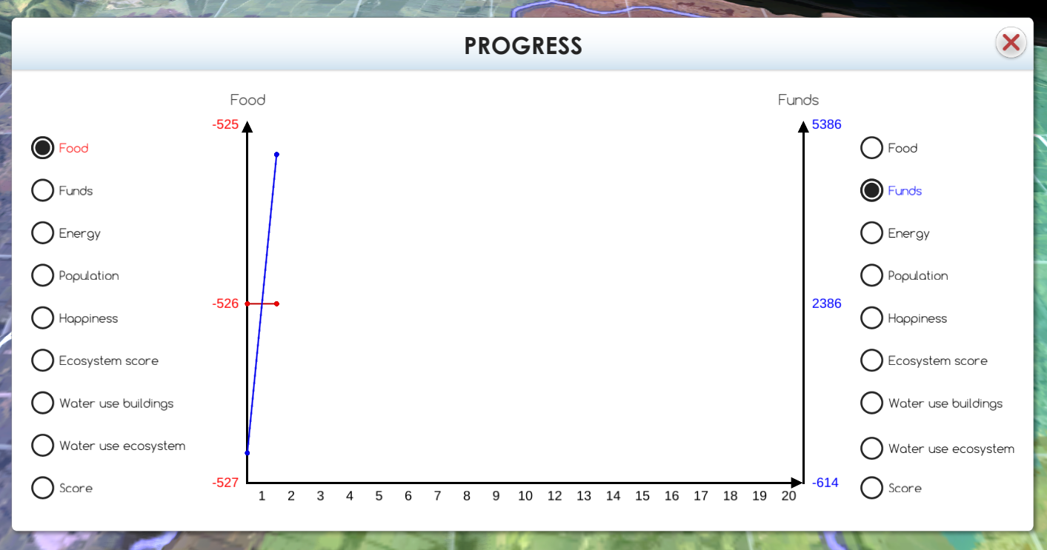
Places to find progress and info

Slide 14
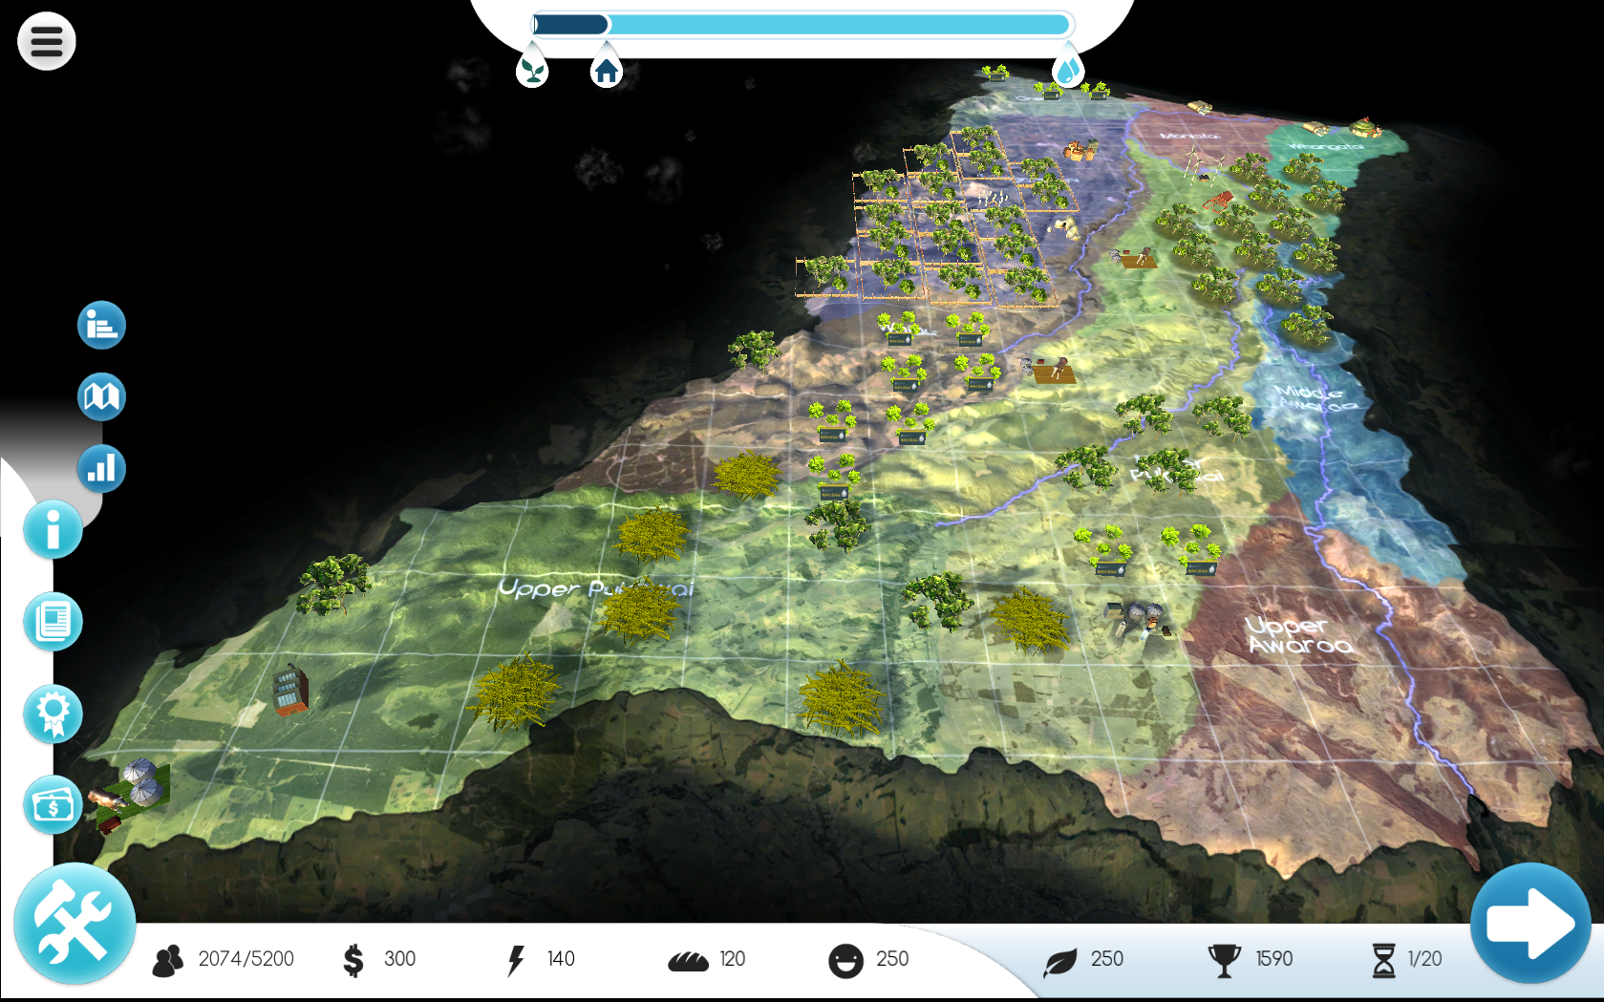
Kaitiakitanga Challenge Terrain

Slide 15
Hints
While the Learn-to-play mission is set up to be straight-forward, the Kaitiakitanga mission is much more challenging. We expect that it will take at least 5 goes to develop a good strategy.
Remember that the game is about Integrated Water Resource Management and so all aspects of the game must be considered to get a high score.
FAQ’s can help guide your game play and are on the website.

Slide 16
How to sign up
You can sign up either via the website, or by emailing rjw@dhigroup.com
http://web.nz.dhigroup.com/DHI.AquaRepublica/

Slide 17
This initiative has been proudly brought to you by
Copyright University of Waikato. All rights reserved.
All images are copyrighted. For further information, please refer to enquiries@sciencelearn.org.nz

Slide 18
Don’t miss Webinar 3
Thursday 29 September at 4.00pm
Reflecting on the challenge
Teachers’ thoughts
Students’ thoughts
Looking forward to the NZ AR Eco Challenge 2017!
© 2016 The University of Waikato www.sciencelearn.org.nz | All Rights Reserved.
All images are copyrighted. For further information, please refer to enquiries@sciencelearn.org.nz

Slide 19
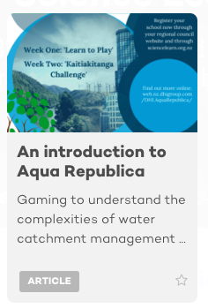
Other Science Learning Hub resources
Article
Webinar
© 2016 The University of Waikato www.sciencelearn.org.nz | All Rights Reserved.
All images are copyrighted. For further information, please refer to enquiries@sciencelearn.org.nzAll images are copyrighted. For further information, please refer to enquiries@sciencelearn.org.nz

Slide 20
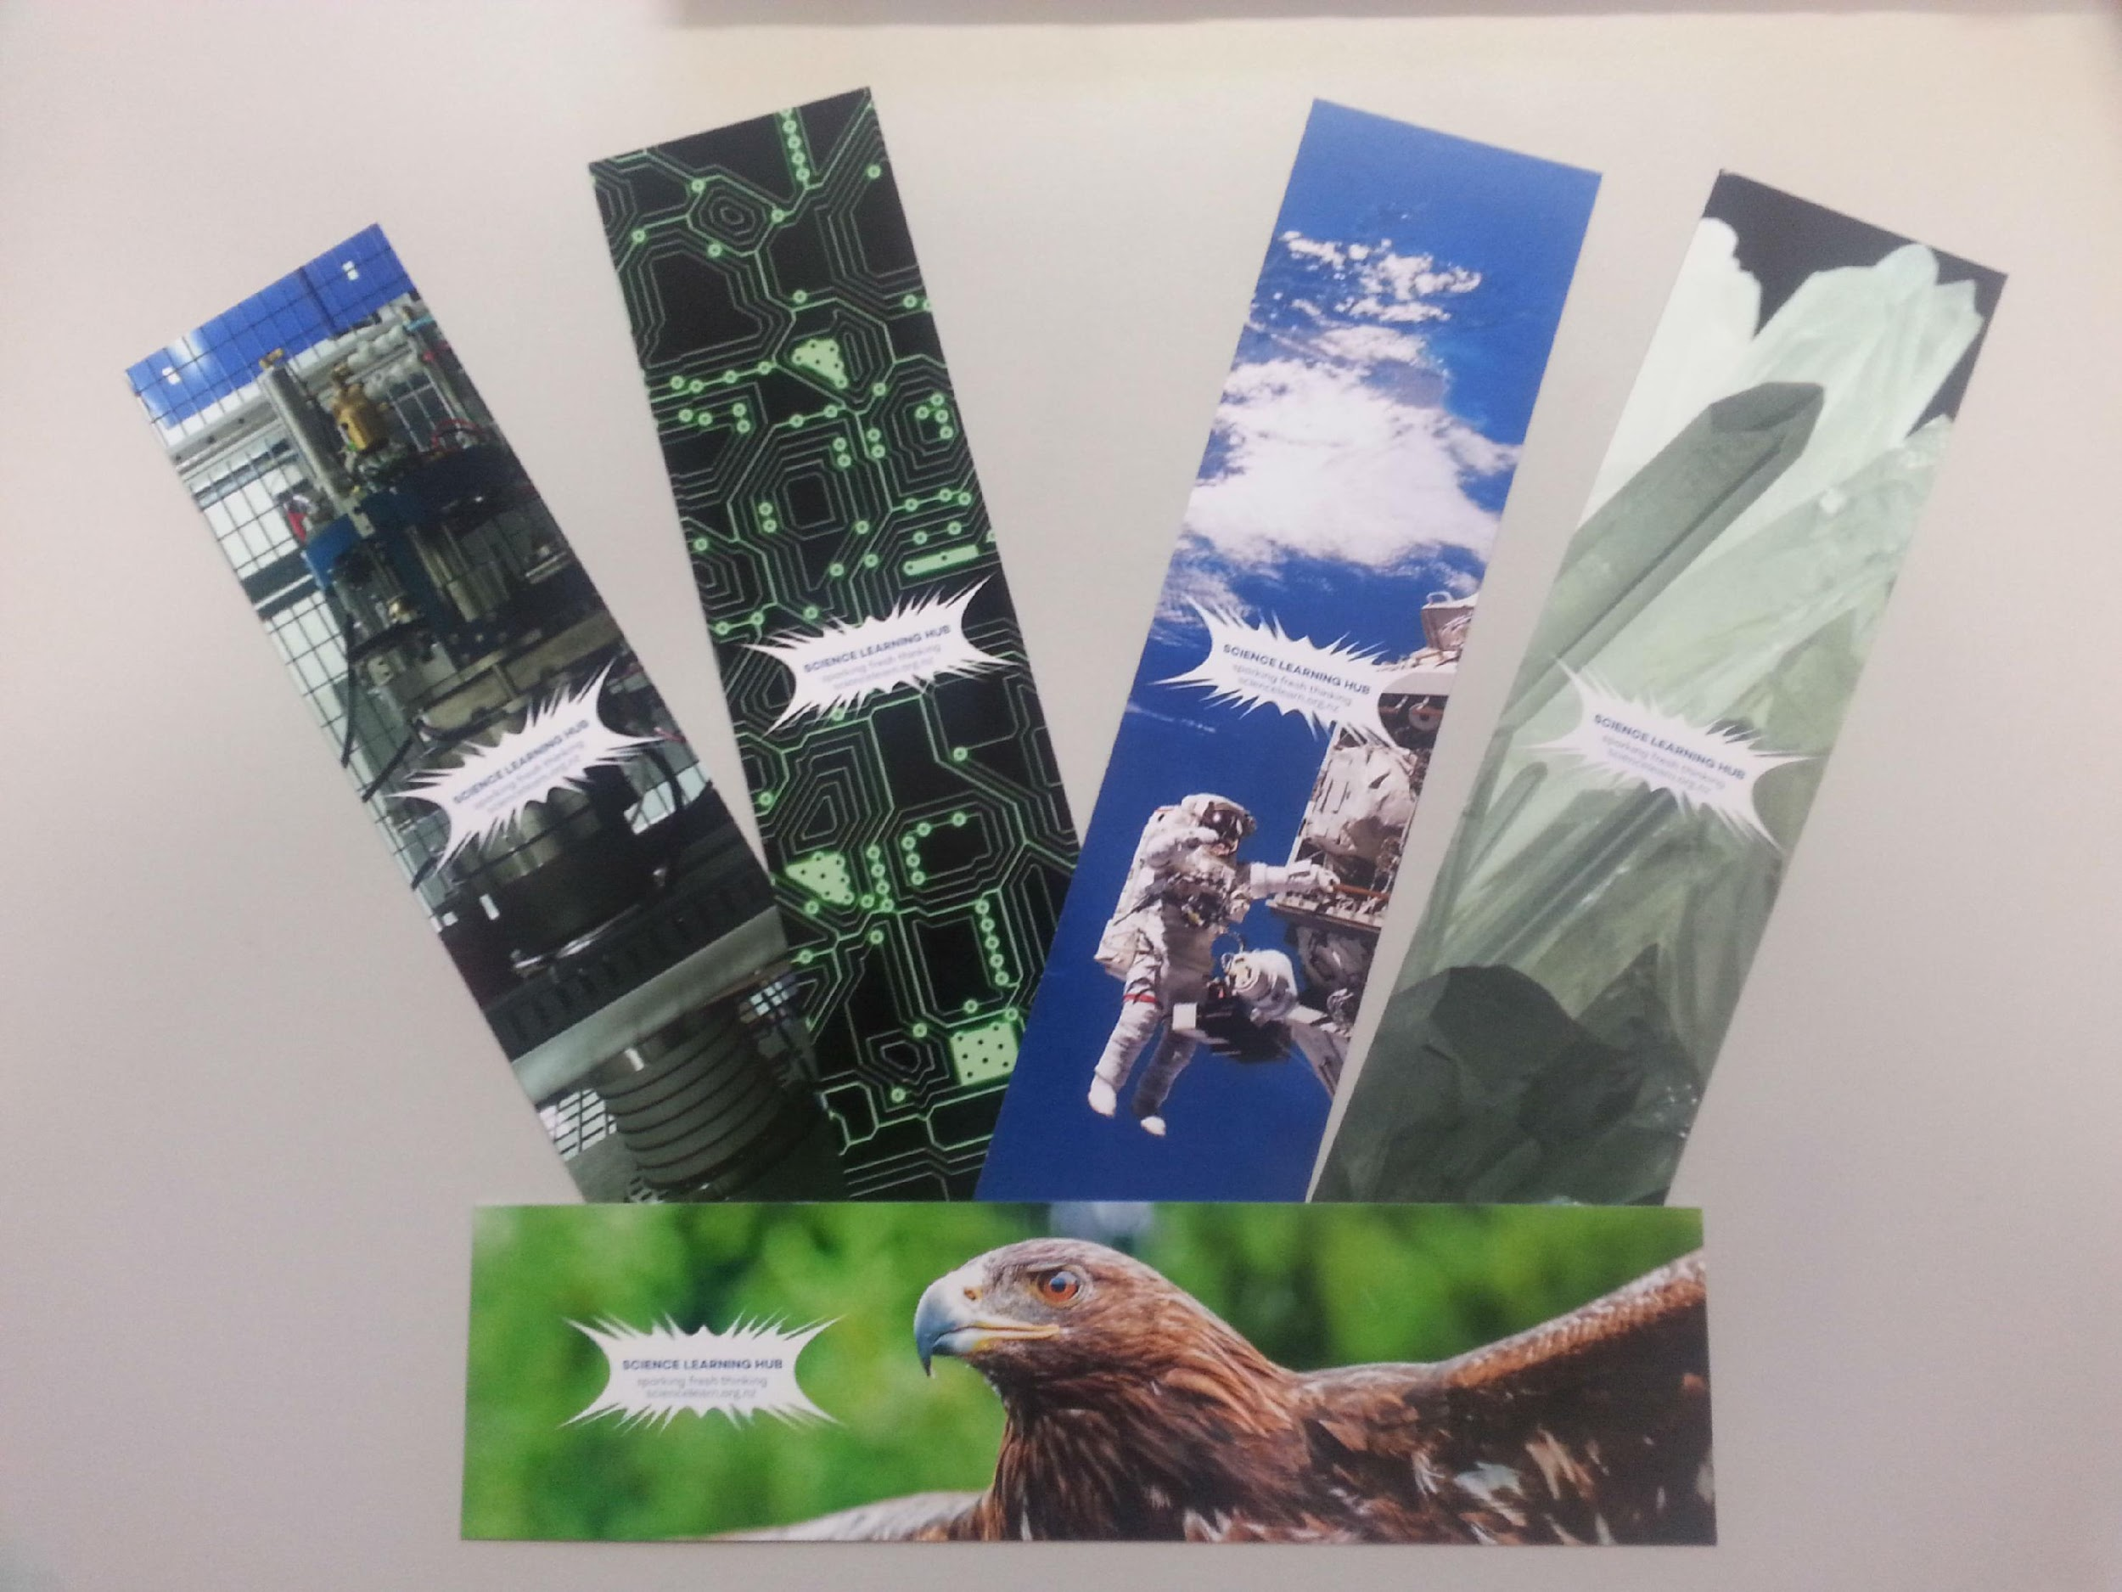
Would you like some bookmarks?
Bookmarks are available – email us enquiries@sciencelearn.org.nz
Follow us on Twitter: https://twitter.com/NZScienceLearn
Like us on Facebook: www.facebook.com/nzsciencelearn
Explore our Pinterest Boards: https://nz.pinterest.com/nzsciencelearn/
Join us in the pond: www.pond.co.nz/community/214015/science-learning-hub
Check out our Aqua Republica and water resource management bucket: www.pond.co.nz/detail/2902262/aqua-republica-water-resource-management
Copyright University of Waikato. All rights reserved.
All images are copyrighted. For further information, please refer to enquiries@sciencelearn.org.nzAll images are copyrighted. For further information, please refer to enquiries@sciencelearn.org.nz

Slide 21
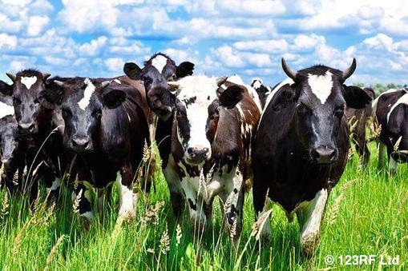
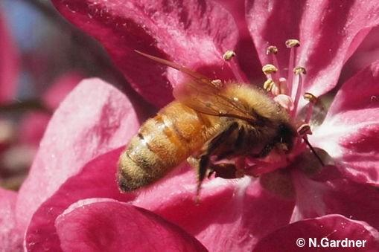
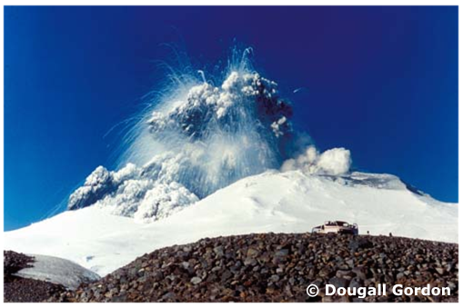
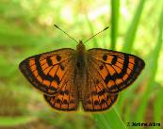
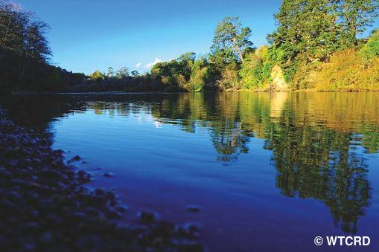
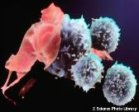
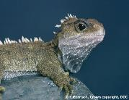
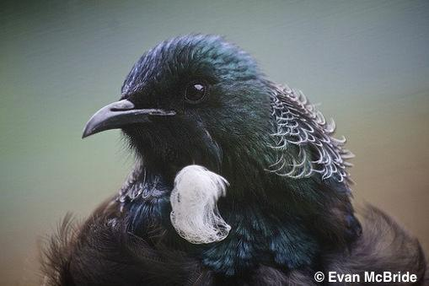
Thanks!
Questions and comments?
The images contained within this PowerPoint presentation are copyrighted to the University of Waikato and other third party individuals and organisations. Any reuse beyond the classroom as per the intended use of these resources, should be cleared with the copyright owner/s.
© THE UNIVERSITY OF WAIKATO • TE WHARE WANANGA O WAIKATO

